Slide 1
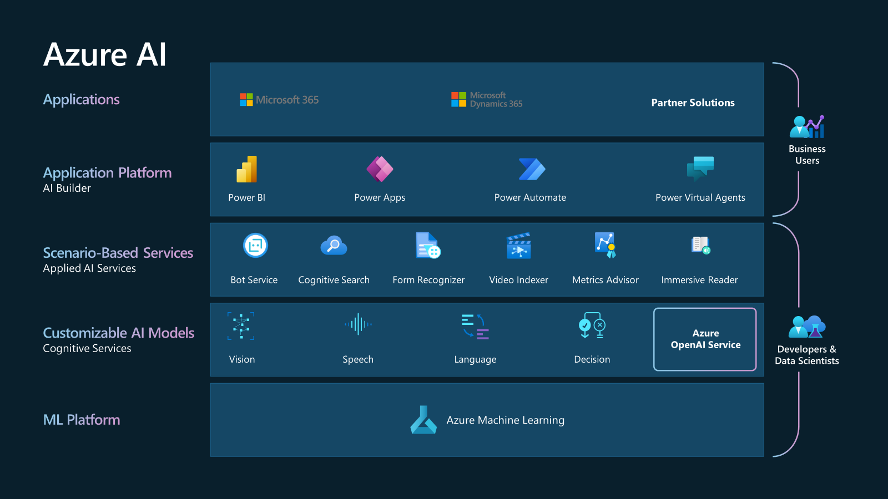

Slide 2
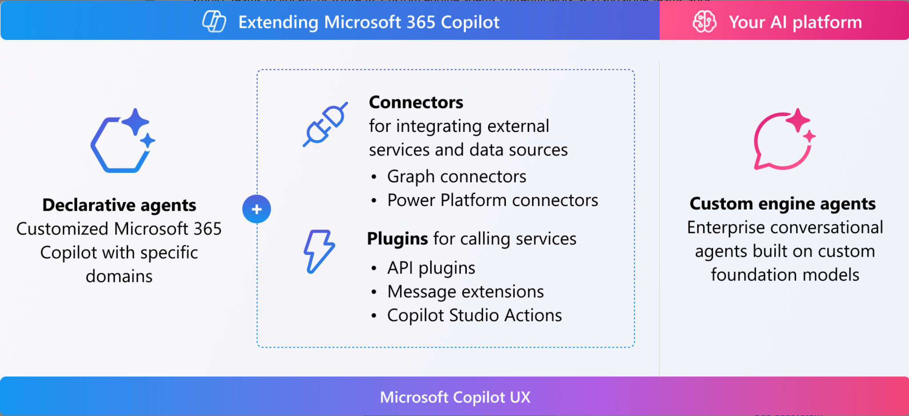
aka.ms/ExtendCopilotM365
Notes:
https://learn.microsoft.com/en-us/microsoft-365-copilot/extensibility/
Plugins for Microsoft Copilot for Microsoft 365 are in public preview and only work in Microsoft 365 Chat in Microsoft Teams.
The capability is enabled by default in all Microsoft 365 Copilot licensed tenants. Admins can disable this functionality on a user and group basis and control how individual plugins are approved for use, and which plugins are enabled. For details see: Manage Plugins for Copilot in Integrated Apps.

Slide 3

Custom Copilot with Azure AI Search & Open AI
Prompt
(Teams) Client
Doc
Private Storage or Database
Doc
Doc
Custom Agent
History
Azure Open AI
Search result
Azure AI Search
Result
Search
Indexer
Private Index
[ Skills ]
Notes:
https://portal.azure.com/#@atwork.at/resource/subscriptions/6fe15cc0-a36c-458f-91d7-e8a4e825276d/resourceGroups/RG-atworkAI/providers/Microsoft.Search/searchServices/atworksearchservice/indexes

Slide 4
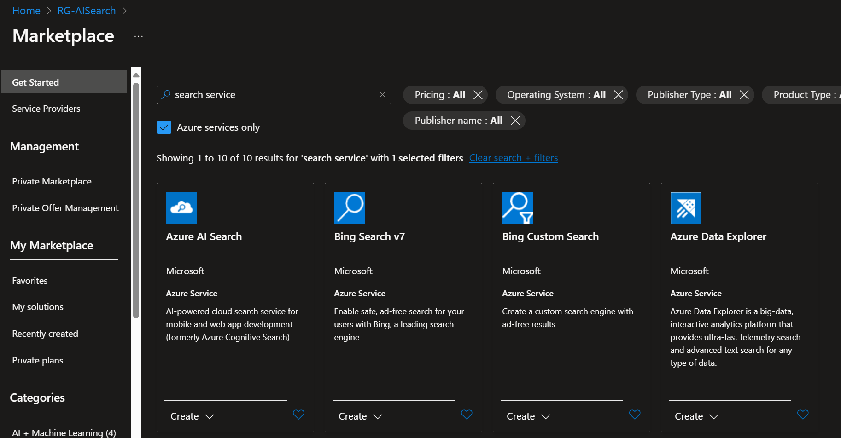
Create the AI Search Service

Slide 5
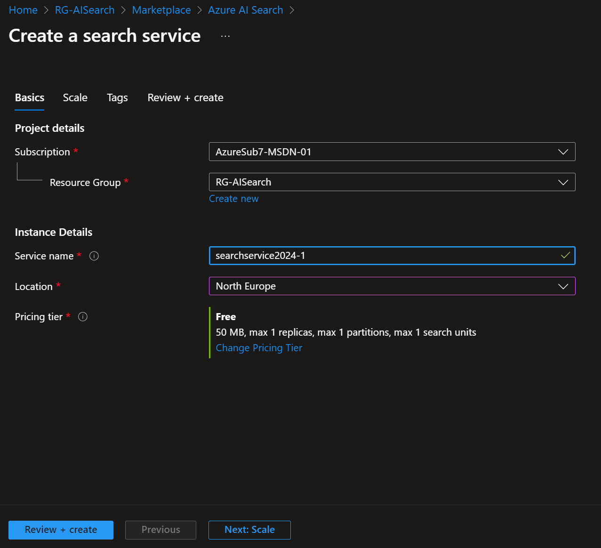

Slide 6
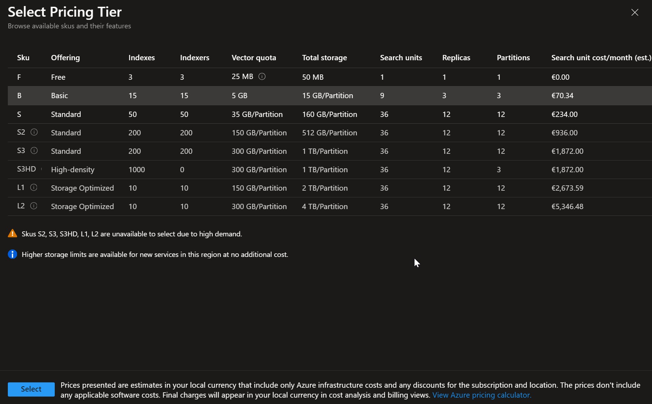

Slide 7
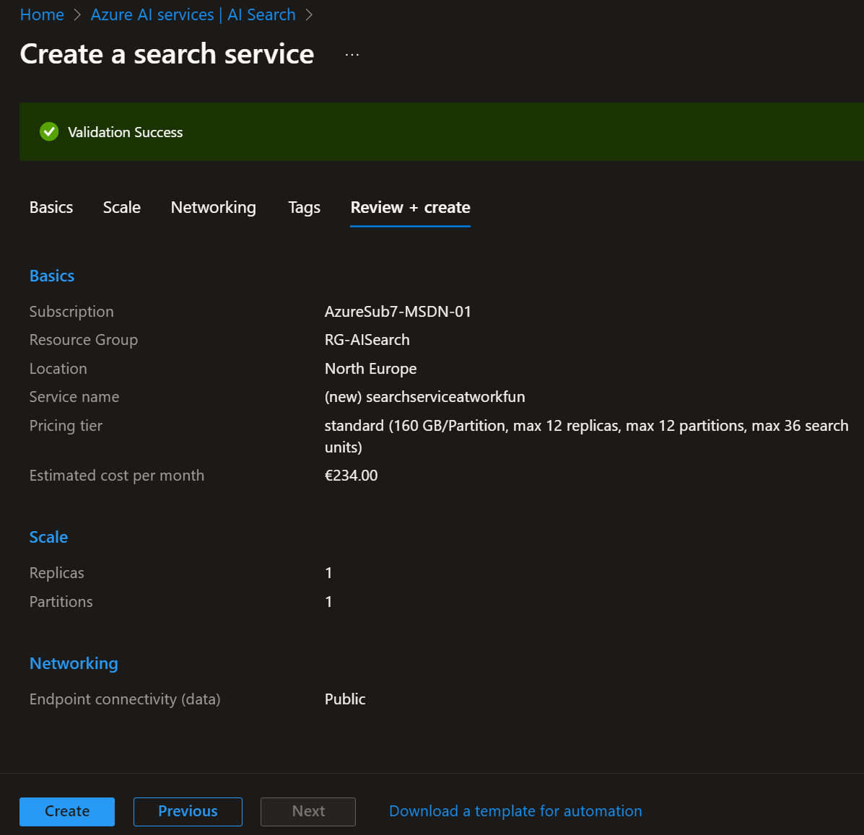

Slide 8
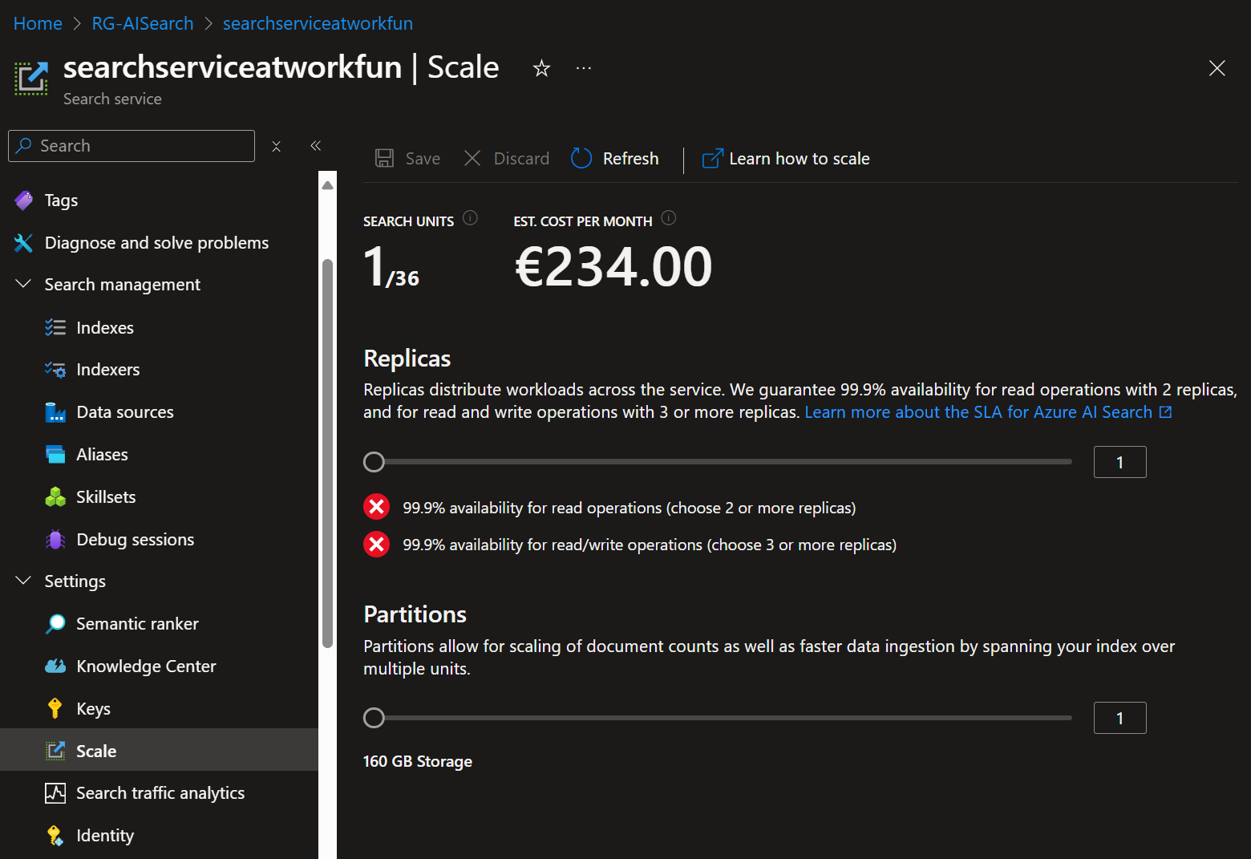
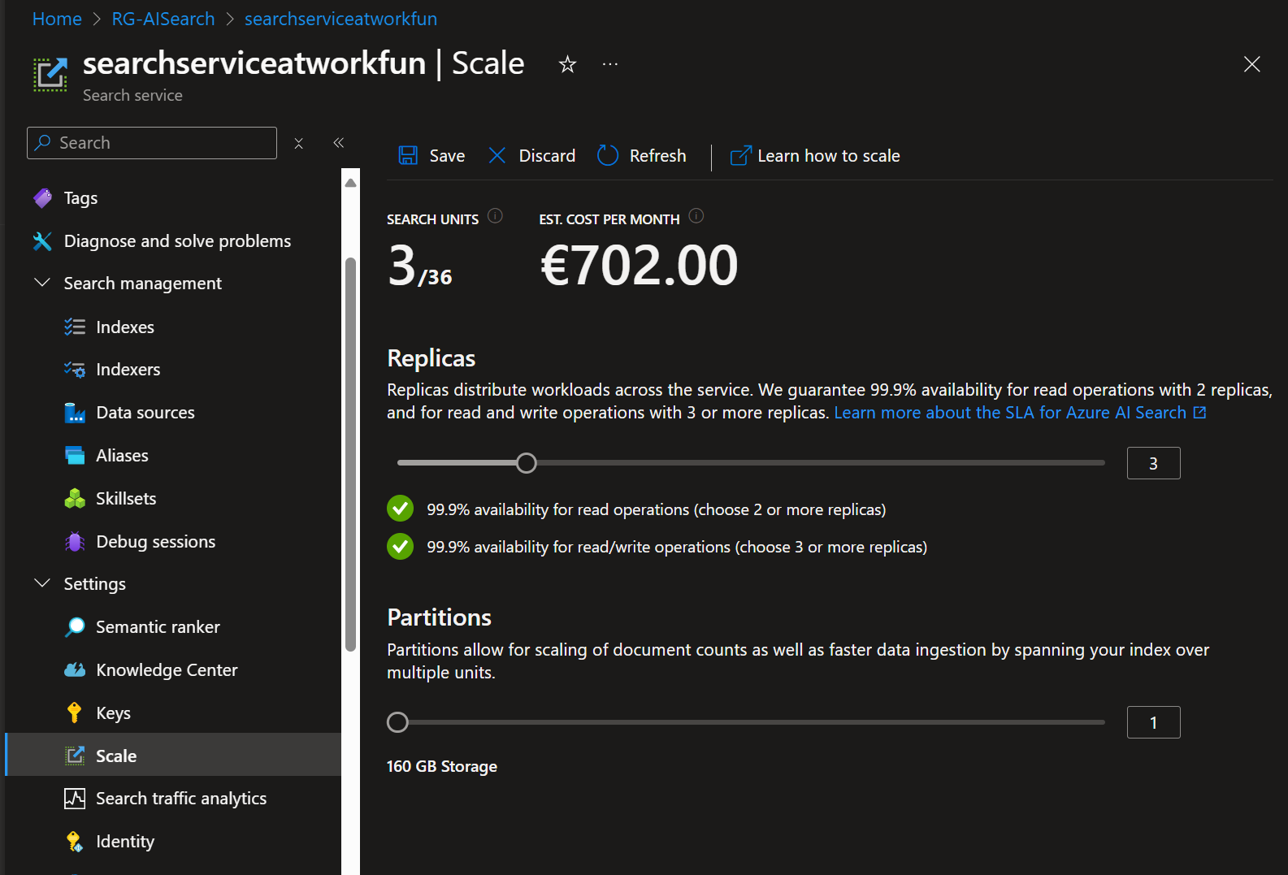

Slide 9
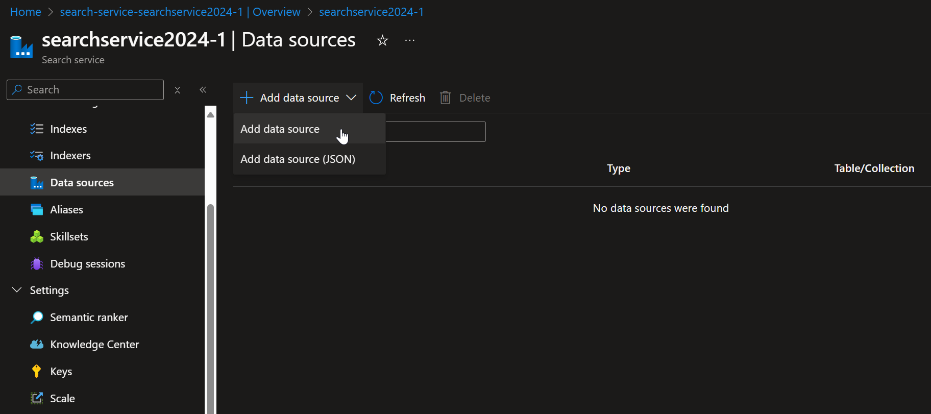
Create a data source

Slide 10
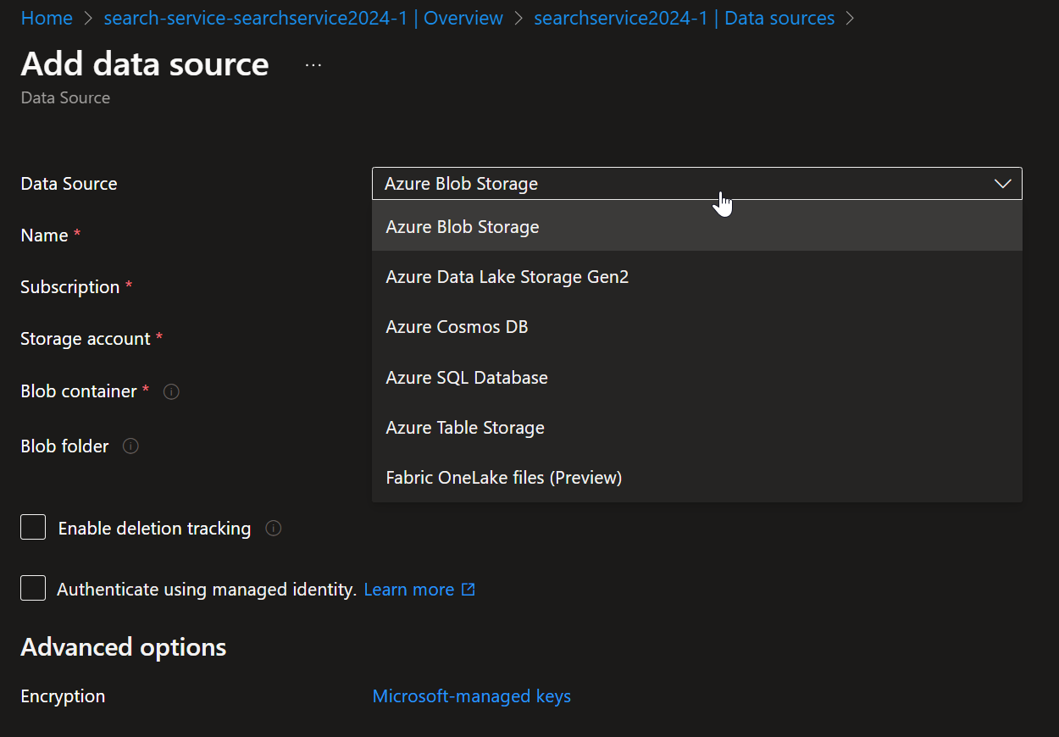
Create a data source

Slide 11
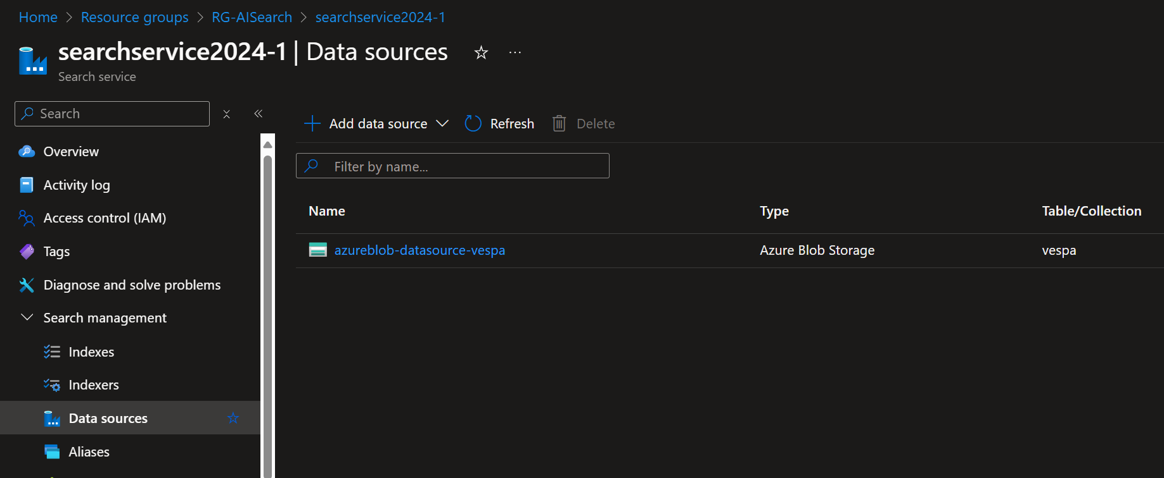
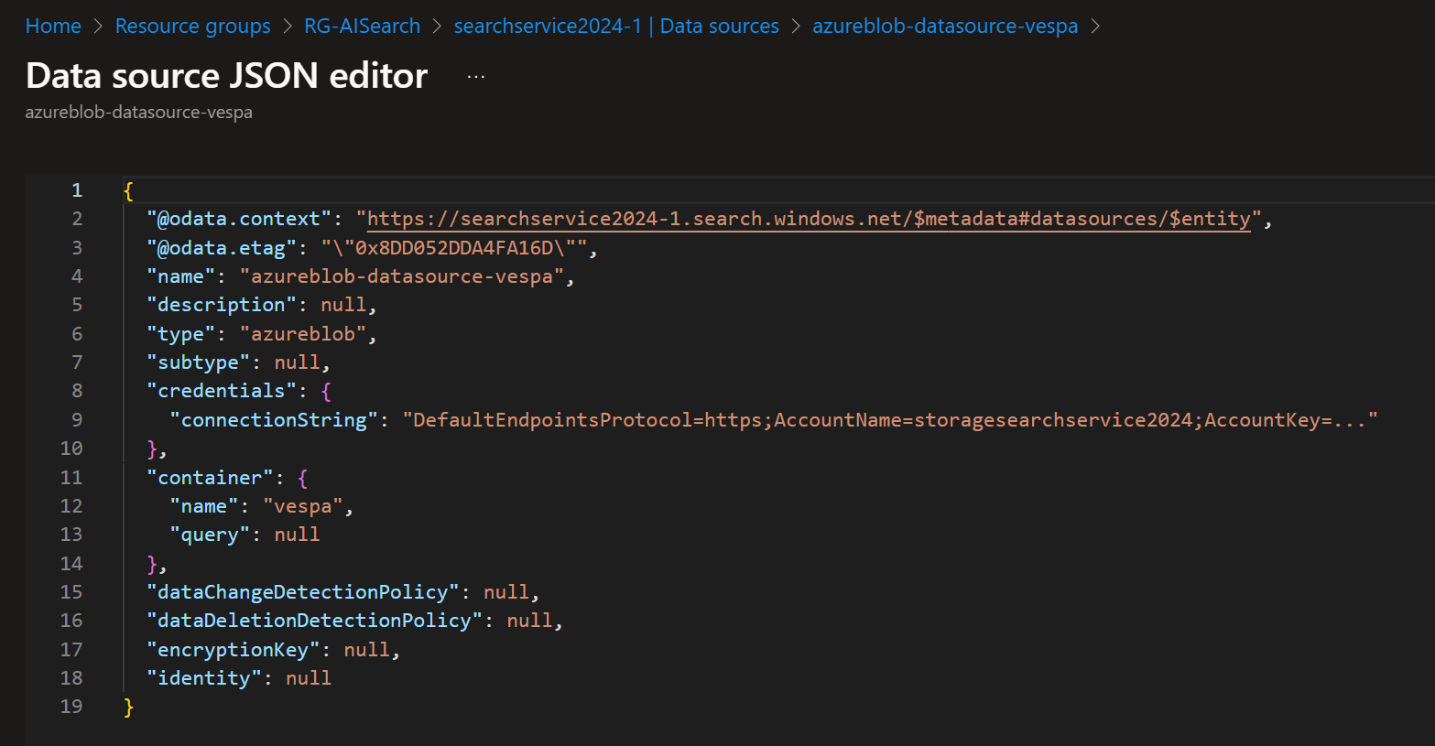
Data source

Slide 12
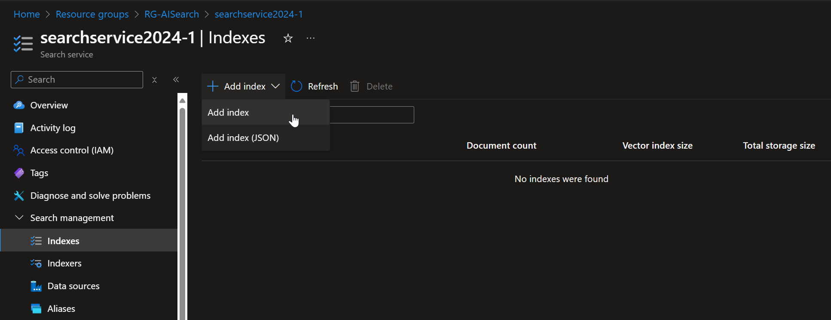
Create an Index

Slide 13
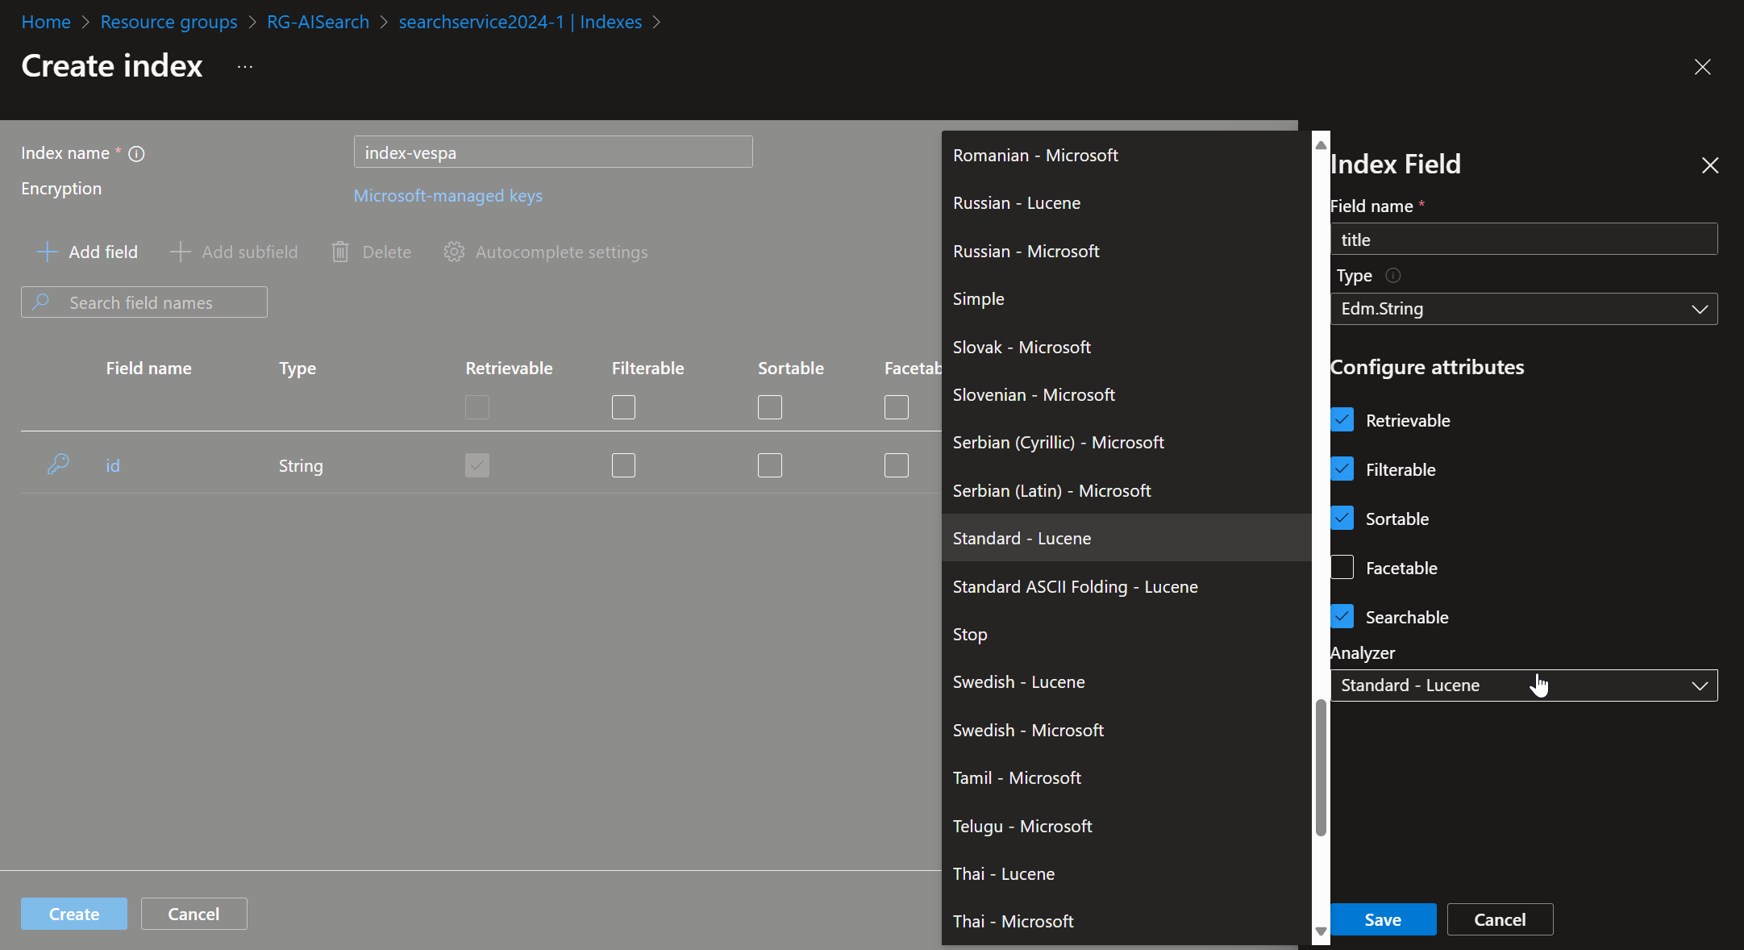

Slide 14
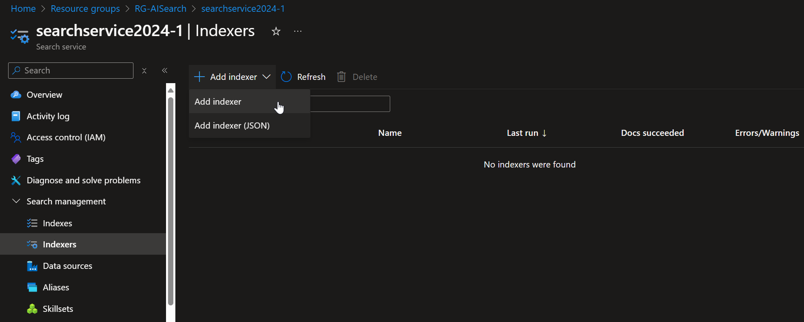
Create an Indexer

Slide 15
Better approach: https://oai.azure.com/
Create the Index, Indexer and Search

Slide 16
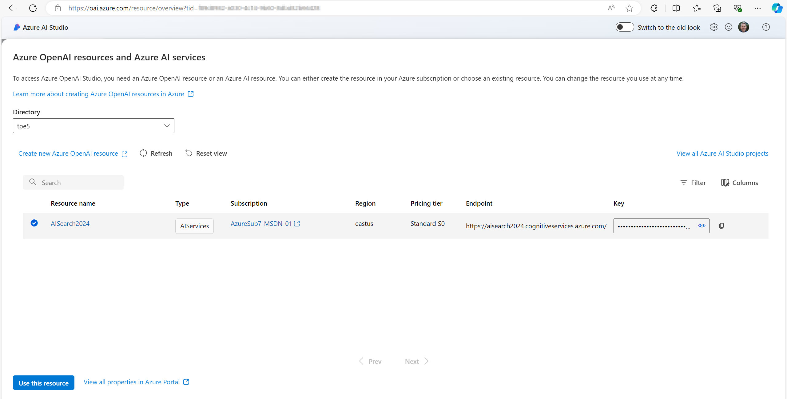

Slide 17
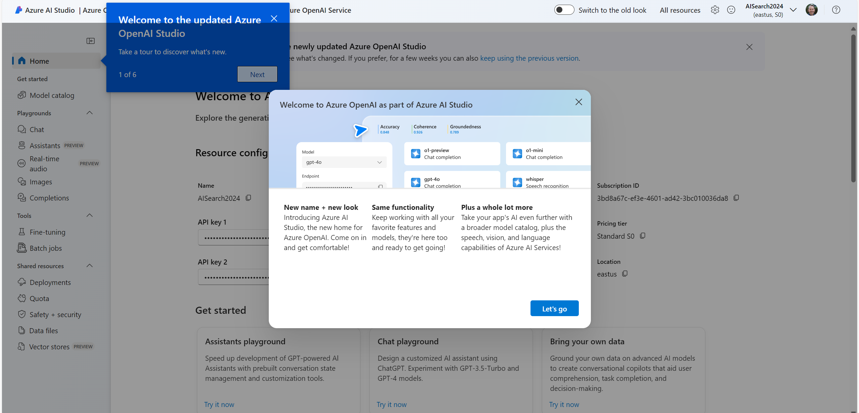

Slide 18
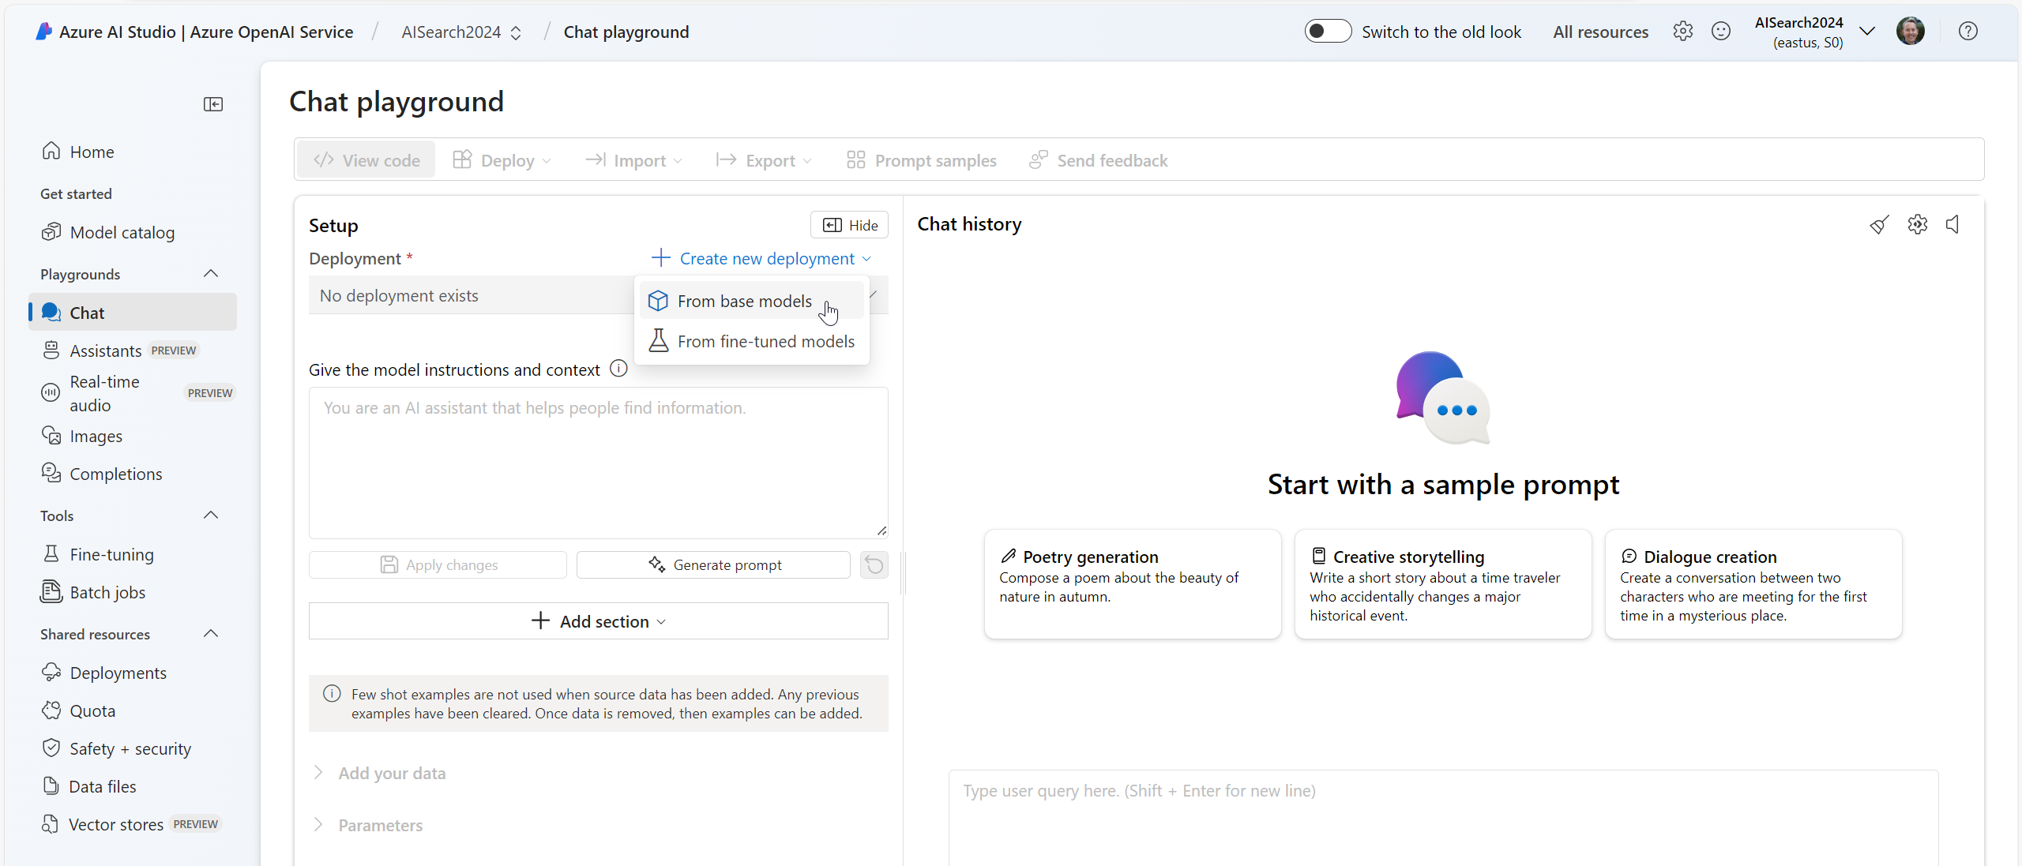

Slide 19
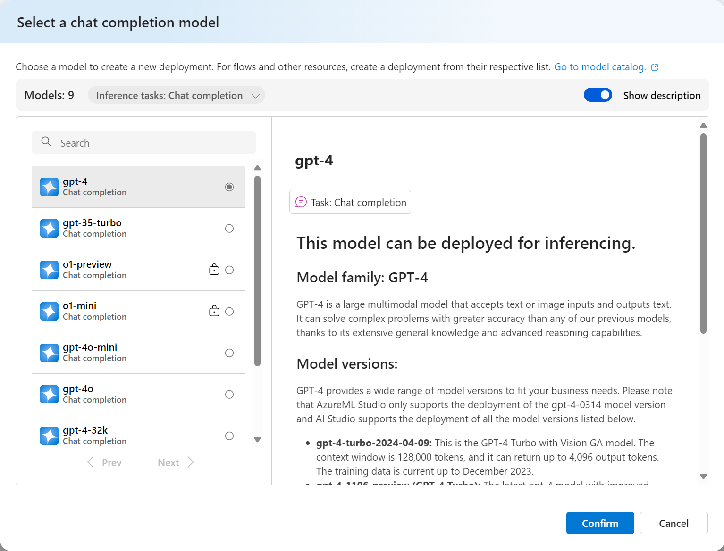

Slide 20
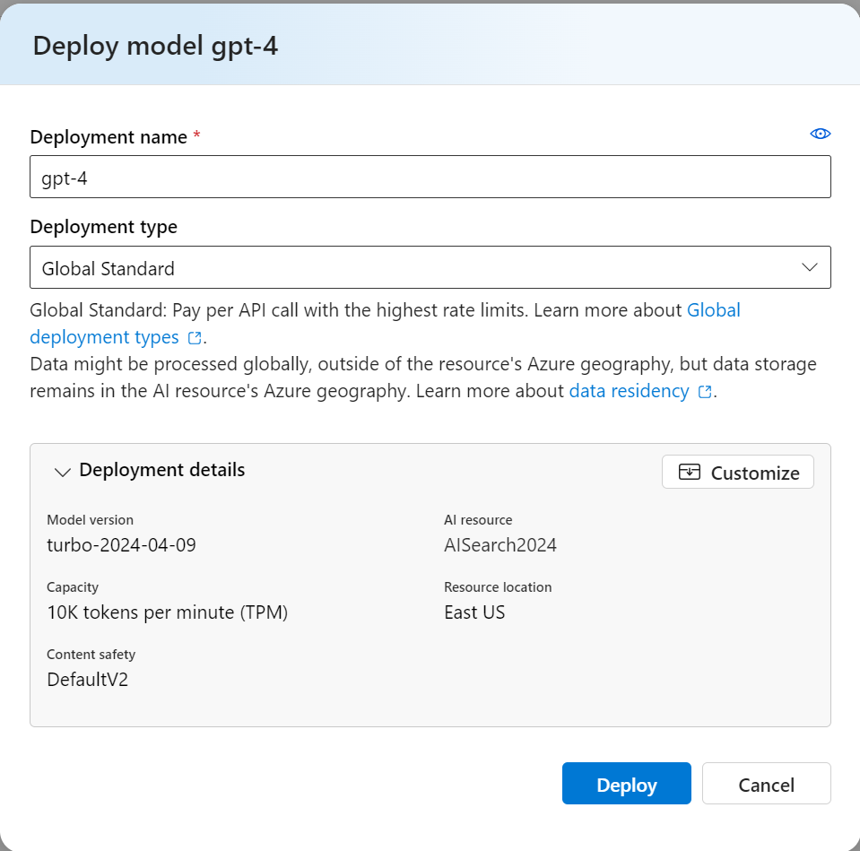

Slide 21
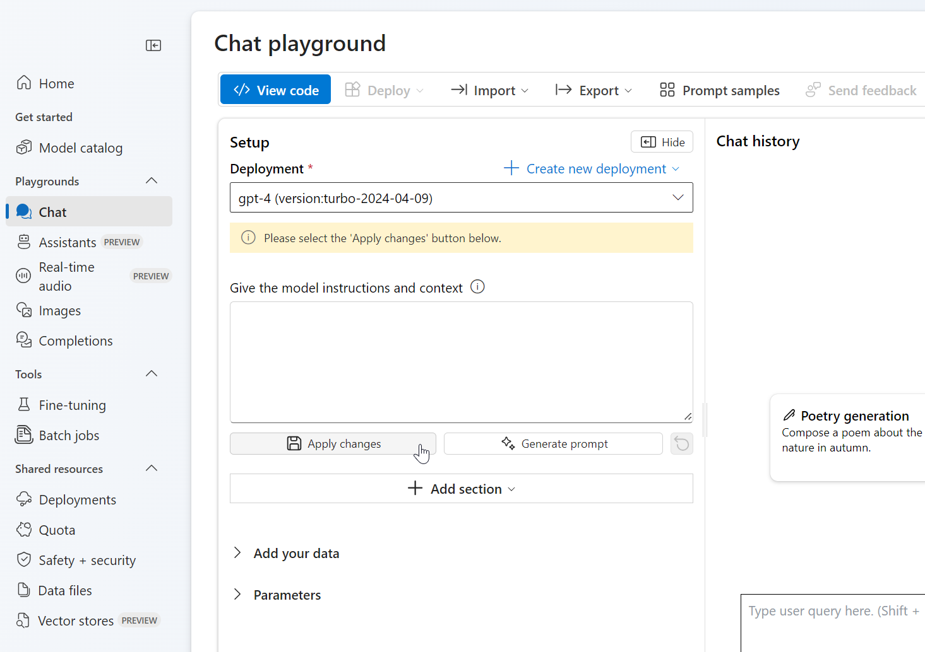

Slide 22
System message
You are the assistant of a mechanic who wants to learn about the history of certain Vespa models and about disassembling and repairing machines and parts of a scooter. Use the data from the data source and from the web. Always provide the data source as a link. Also try to find related parts.

Slide 23
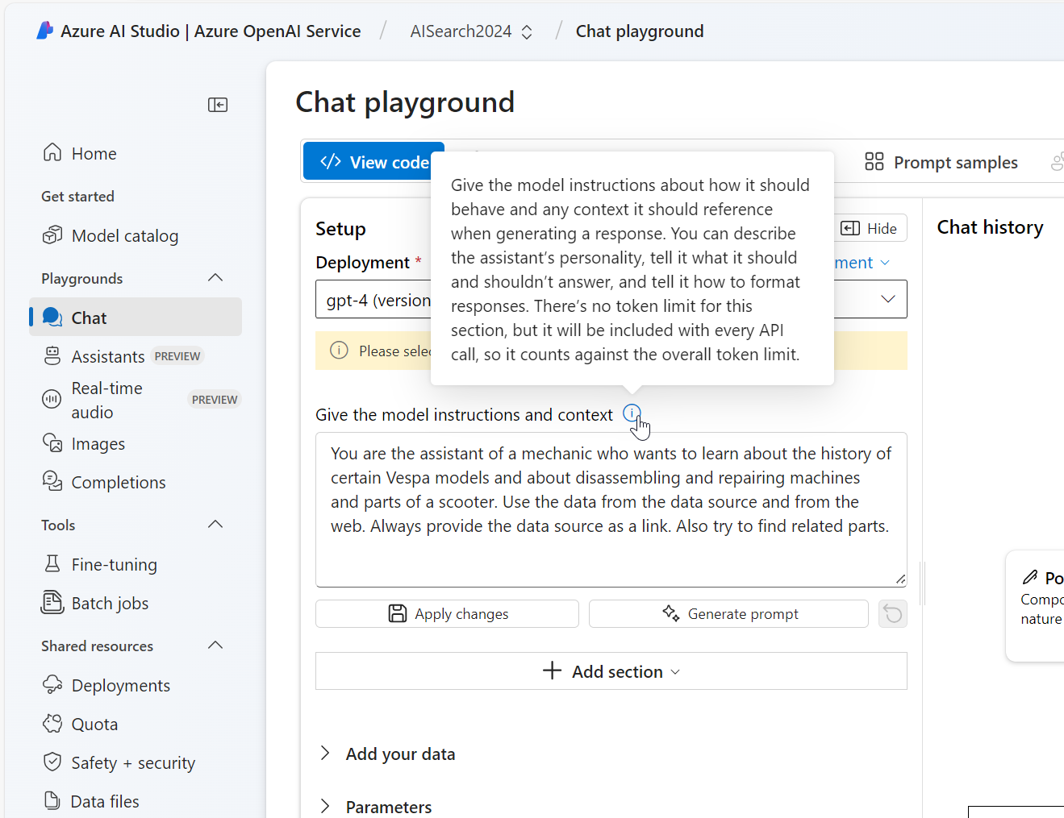

Slide 24
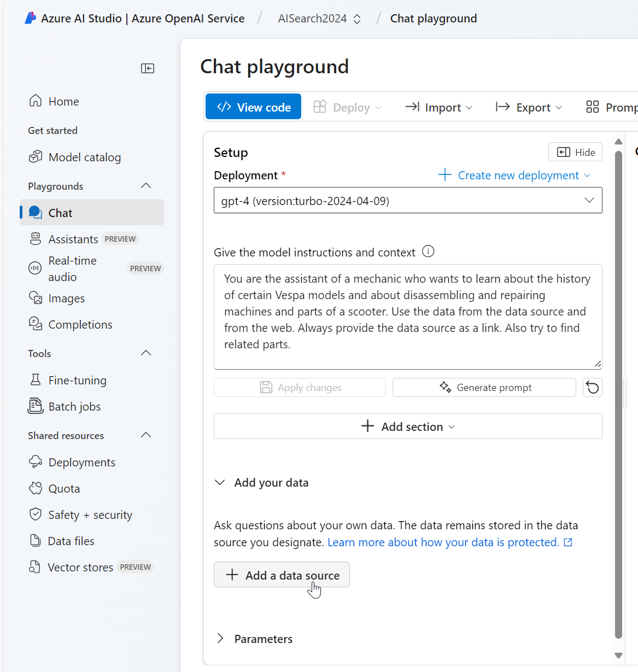

Slide 25
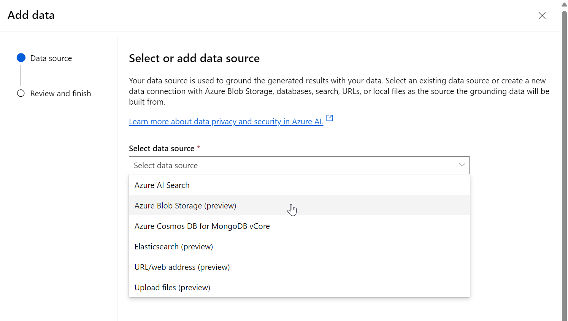

Slide 26
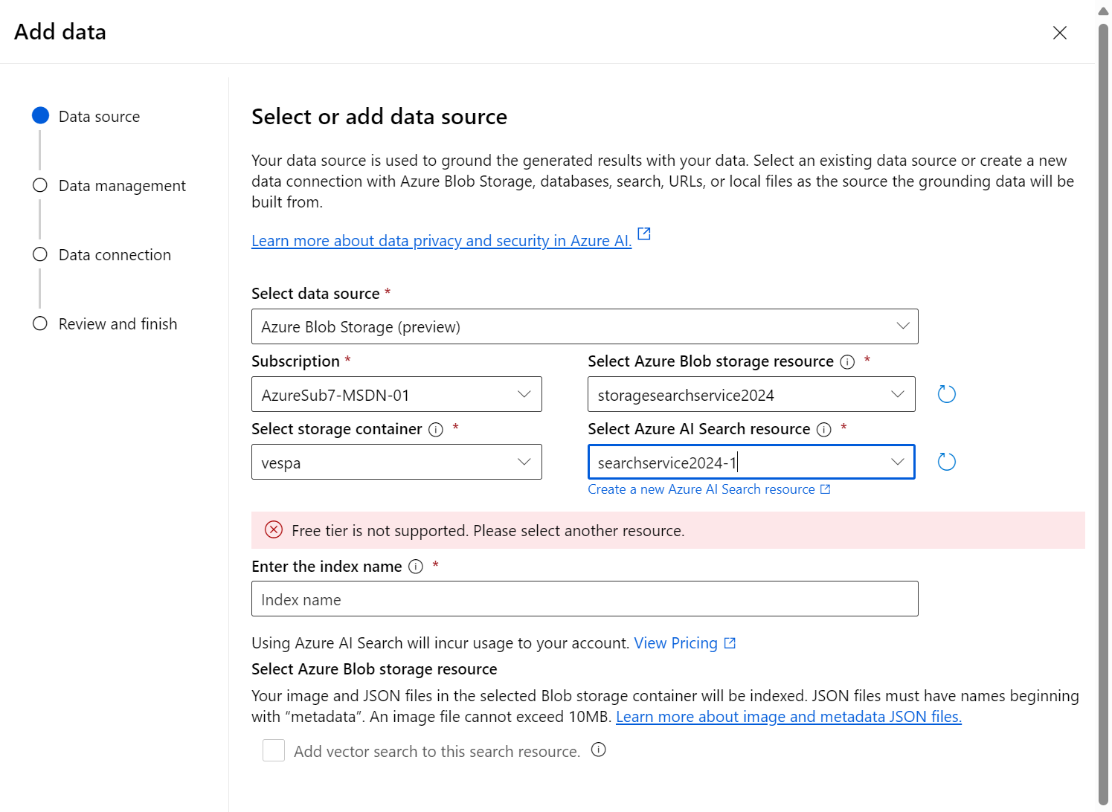

Slide 27
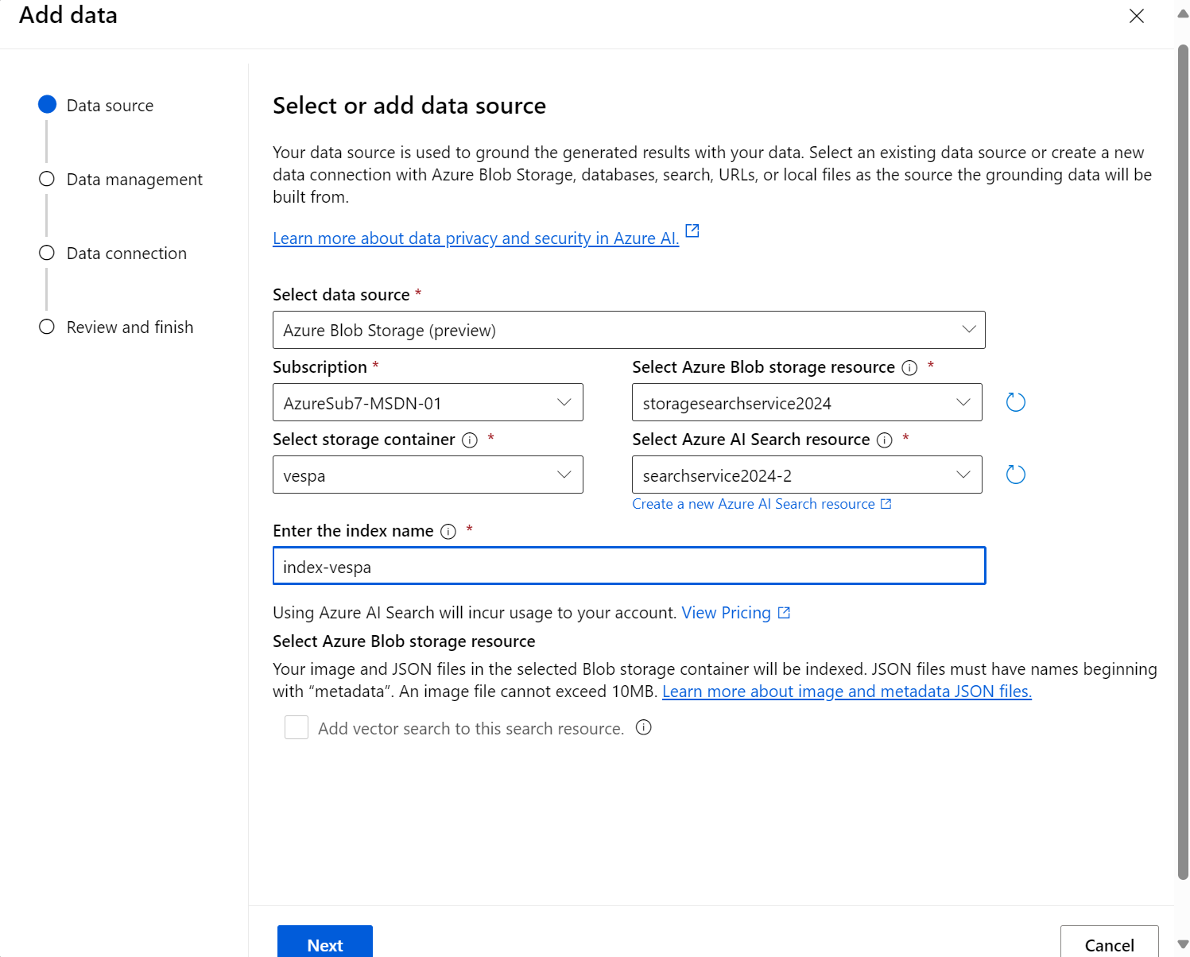

Slide 28
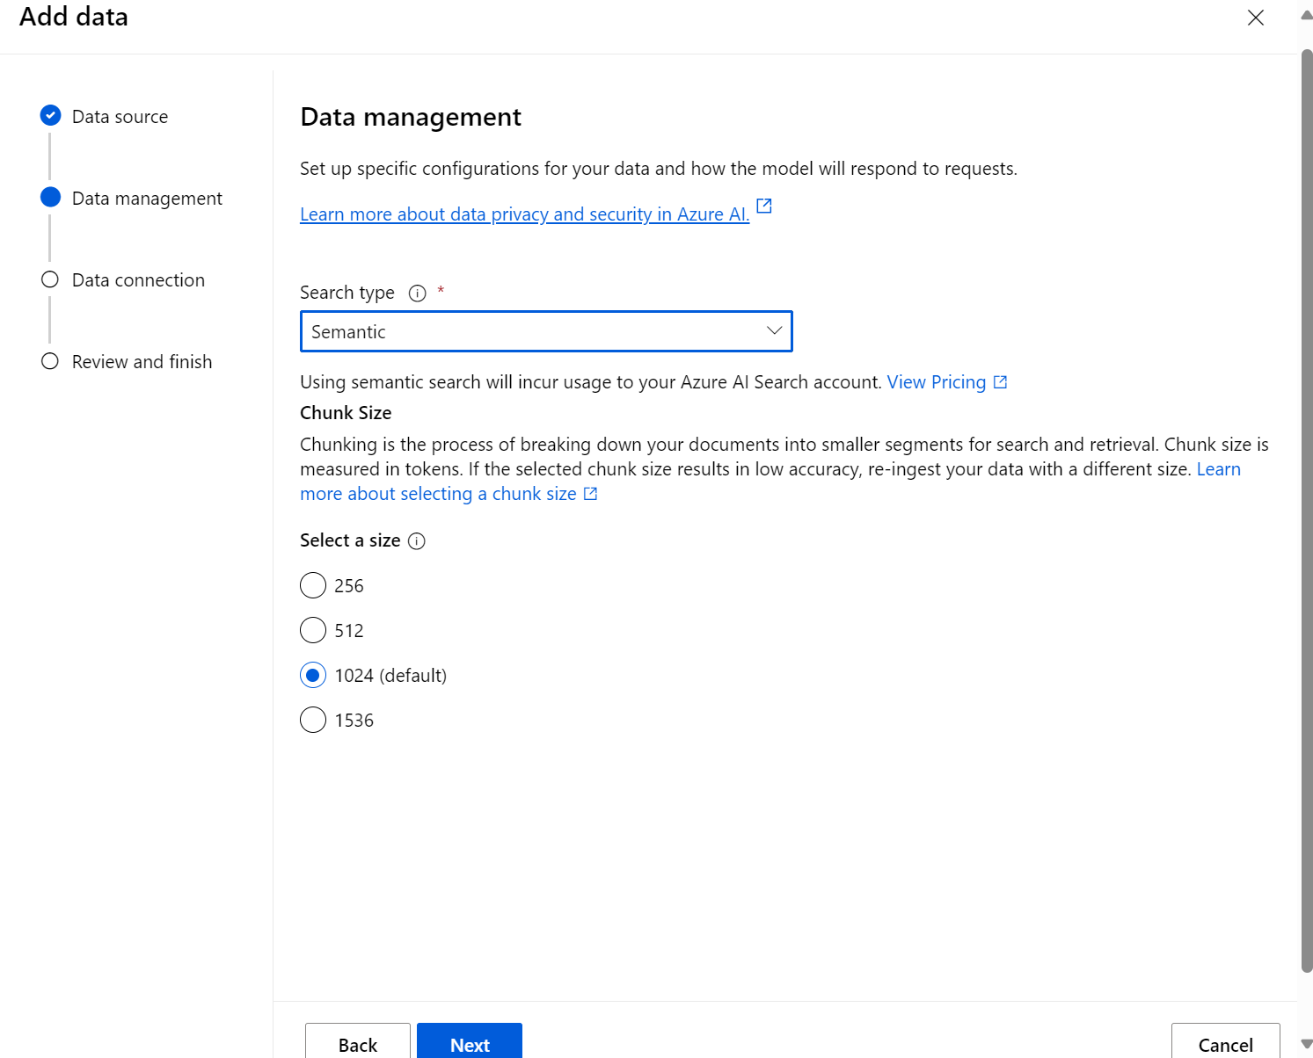

Slide 29
Azure AI Search Details

Slide 30
Tokens?
Azure AI Search is powerful.
1 2 3 4 5 6

Slide 31
Tokens?
Understanding natural language processing is fascinating.
So, the tokens would be:
Understand
ing
natural
language
process
ing
is
fascinate
Ing
.
Subword tokenization, is useful for handling rare or complex words by breaking them down into more common subwords.
Notes:
subword tokenization, is useful for handling rare or complex words by breaking them down into more common subwords

Slide 32
Vectors?
These vectors are typically generated using machine learning models like Word2Vec, GloVe, or BERT, which learn to represent words in a way that captures their semantic meaning. The actual vectors would be much longer and more complex, but this simplified example gives you an idea of how each word can be represented numerically.
Azure AI Search is powerful.
Azure: [0.1, 0.3, 0.5, 0.7]
AI: [0.2, 0.4, 0.6, 0.8]
Search: [0.3, 0.5, 0.7, 0.9]
is: [0.0, 0.1, 0.2, 0.3]
powerful: [0.4, 0.6, 0.8, 1.0]

Slide 33
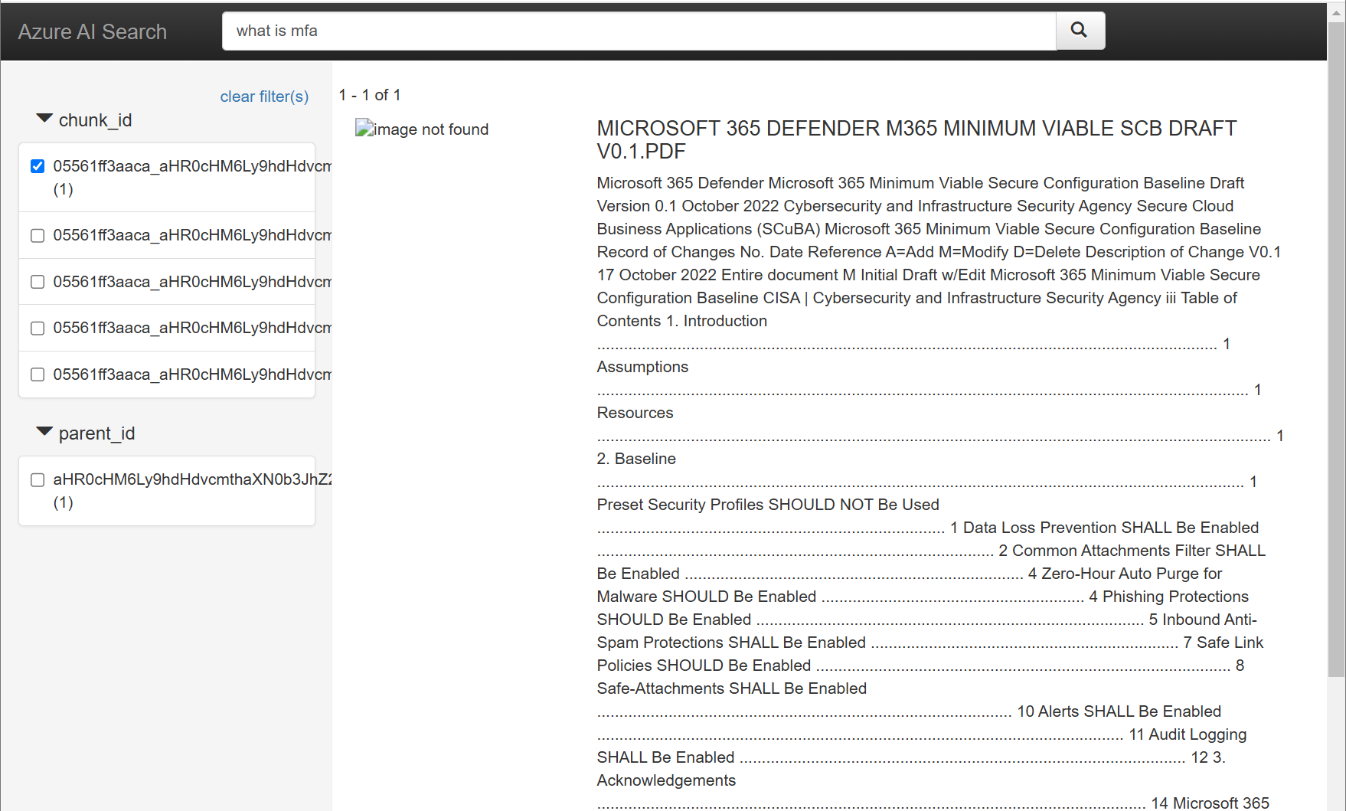
Chunks?
Chunking is the process of breaking down your documents into smaller segments for search and retrieval. Chunk size is measured in tokens. If the selected chunk size results in low accuracy, re-ingest your data with a different size
Notes:
Chunking is the process of breaking down your documents into smaller segments for search and retrieval. Chunk size is measured in tokens. If the selected chunk size results in low accuracy, re-ingest your data with a different size

Slide 34
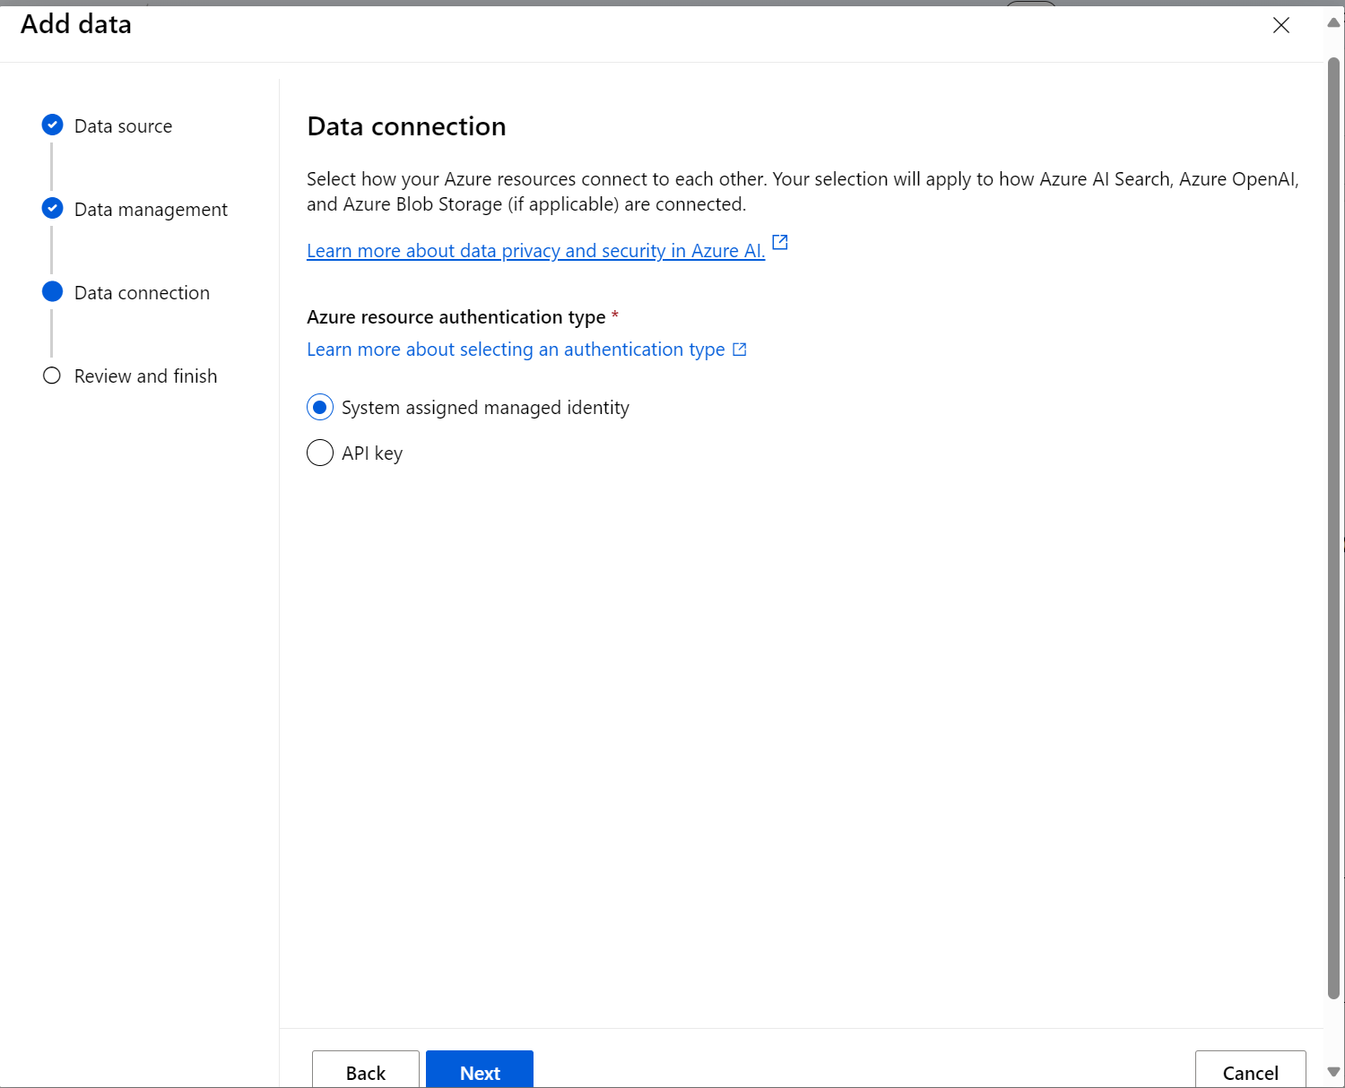
Notes:
The Azure AI Search resource has disabled RBAC authentication
The Azure AI Search system assigned managed identity doesn't have required role assignment to Azure OpenAI resource: Cognitive Services OpenAI Contributor. Adding role assignments takes about 10 minutes to take effect.
The Azure AI Search system assigned managed identity doesn't have required role assignment to the Storage account: Storage Blob Data Reader. Adding role assignments takes about 10 minutes to take effect.
The Azure OpenAI system assigned managed identity doesn't have required role assignment to the Storage account: Storage Blob Data Contributor. Adding role assignments takes about 10 minutes to take effect.
The Azure AI Search resource has disabled RBAC authentication
The Azure OpenAI system assigned managed identity doesn't have required role assignment to the Storage account: Storage Blob Data Contributor. Adding role assignments takes about 10 minutes to take effect.
https://learn.microsoft.com/en-us/azure/ai-services/openai/how-to/use-your-data-securely#role-assignments

Slide 35
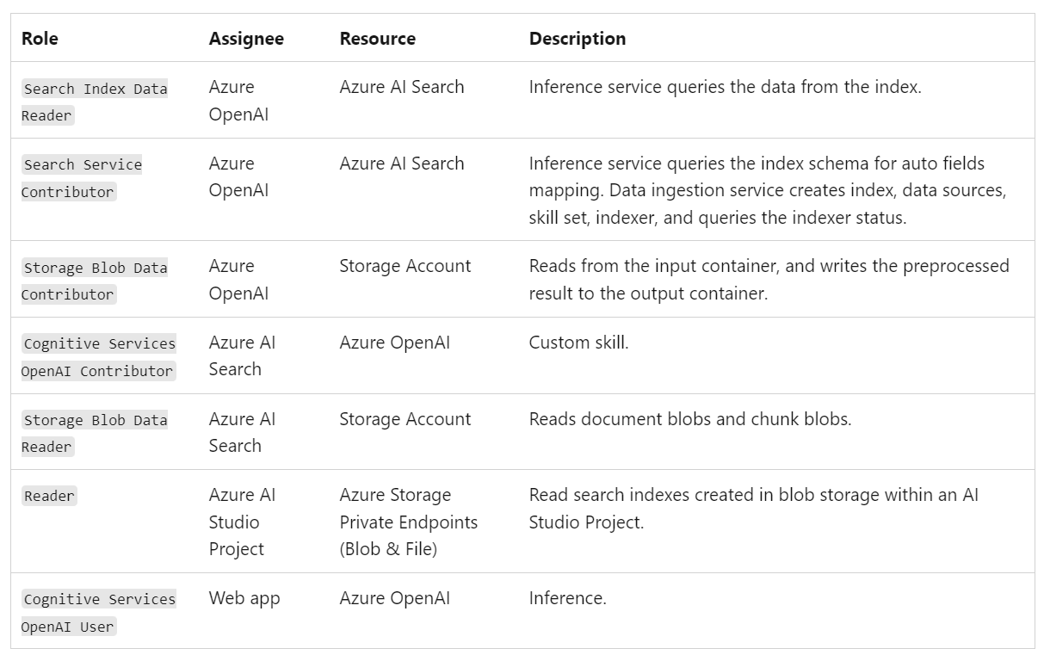
Required RBAC Permissions for Managed Identities
https://learn.microsoft.com/en-us/azure/ai-services/openai/how-to/use-your-data-securely#role-assignments
Notes:
The Azure AI Search resource has disabled RBAC authentication
The Azure AI Search system assigned managed identity doesn't have required role assignment to Azure OpenAI resource: Cognitive Services OpenAI Contributor. Adding role assignments takes about 10 minutes to take effect.
The Azure AI Search system assigned managed identity doesn't have required role assignment to the Storage account: Storage Blob Data Reader. Adding role assignments takes about 10 minutes to take effect.
The Azure OpenAI system assigned managed identity doesn't have required role assignment to the Storage account: Storage Blob Data Contributor. Adding role assignments takes about 10 minutes to take effect.
The Azure AI Search resource has disabled RBAC authentication
The Azure OpenAI system assigned managed identity doesn't have required role assignment to the Storage account: Storage Blob Data Contributor. Adding role assignments takes about 10 minutes to take effect.
https://learn.microsoft.com/en-us/azure/ai-services/openai/how-to/use-your-data-securely#role-assignments

Slide 36
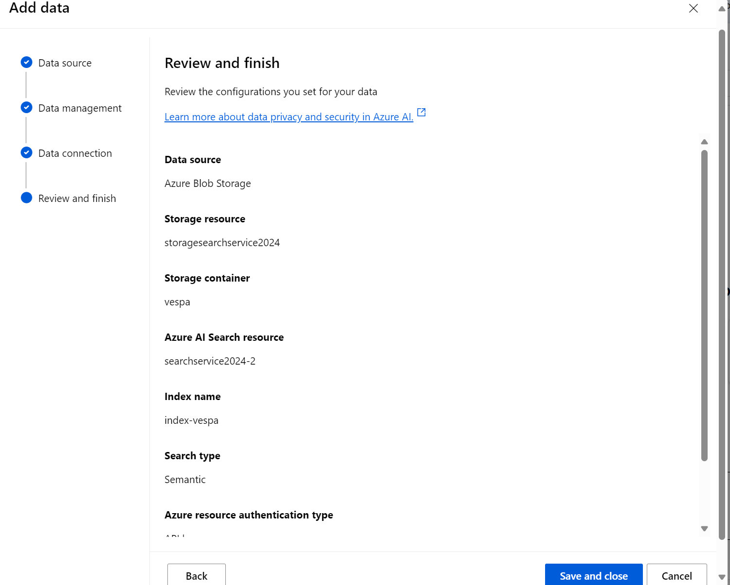

Slide 37
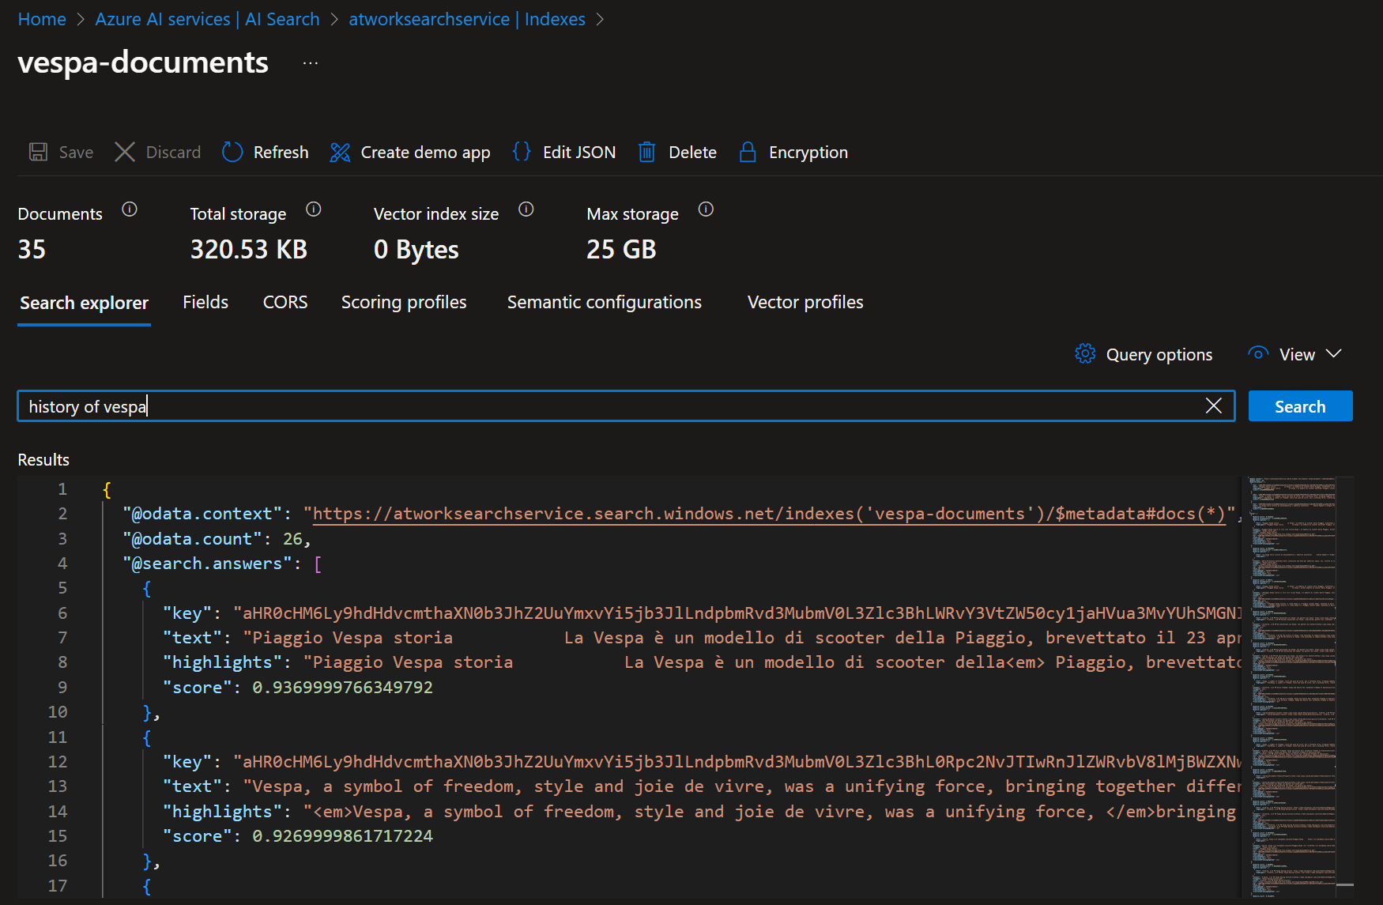

Slide 38
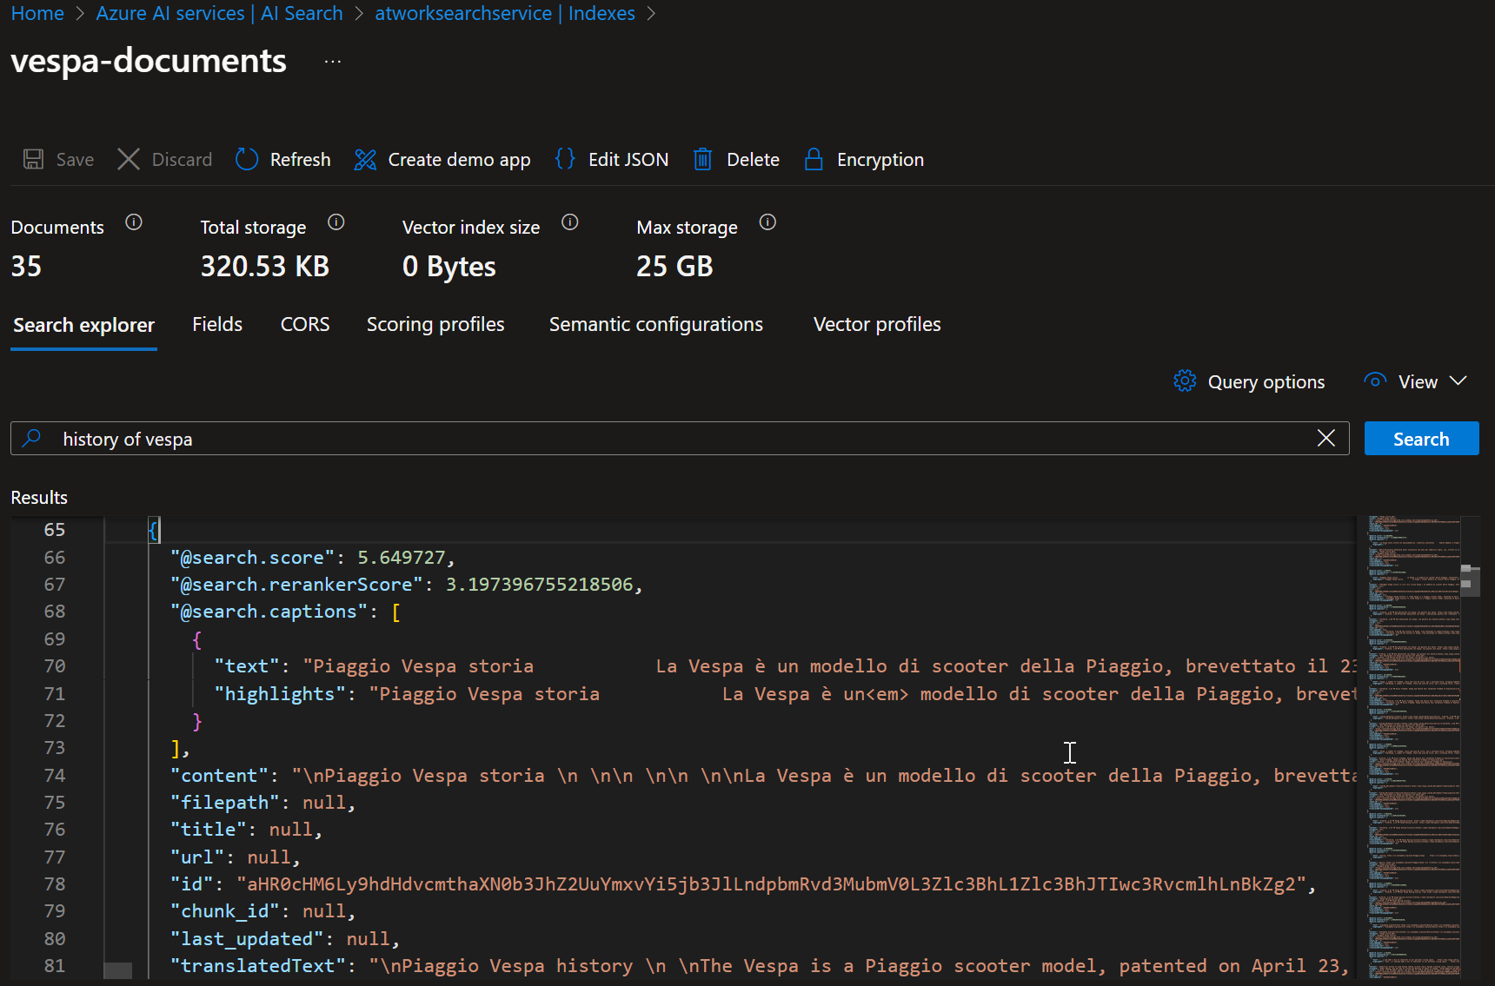

Slide 39
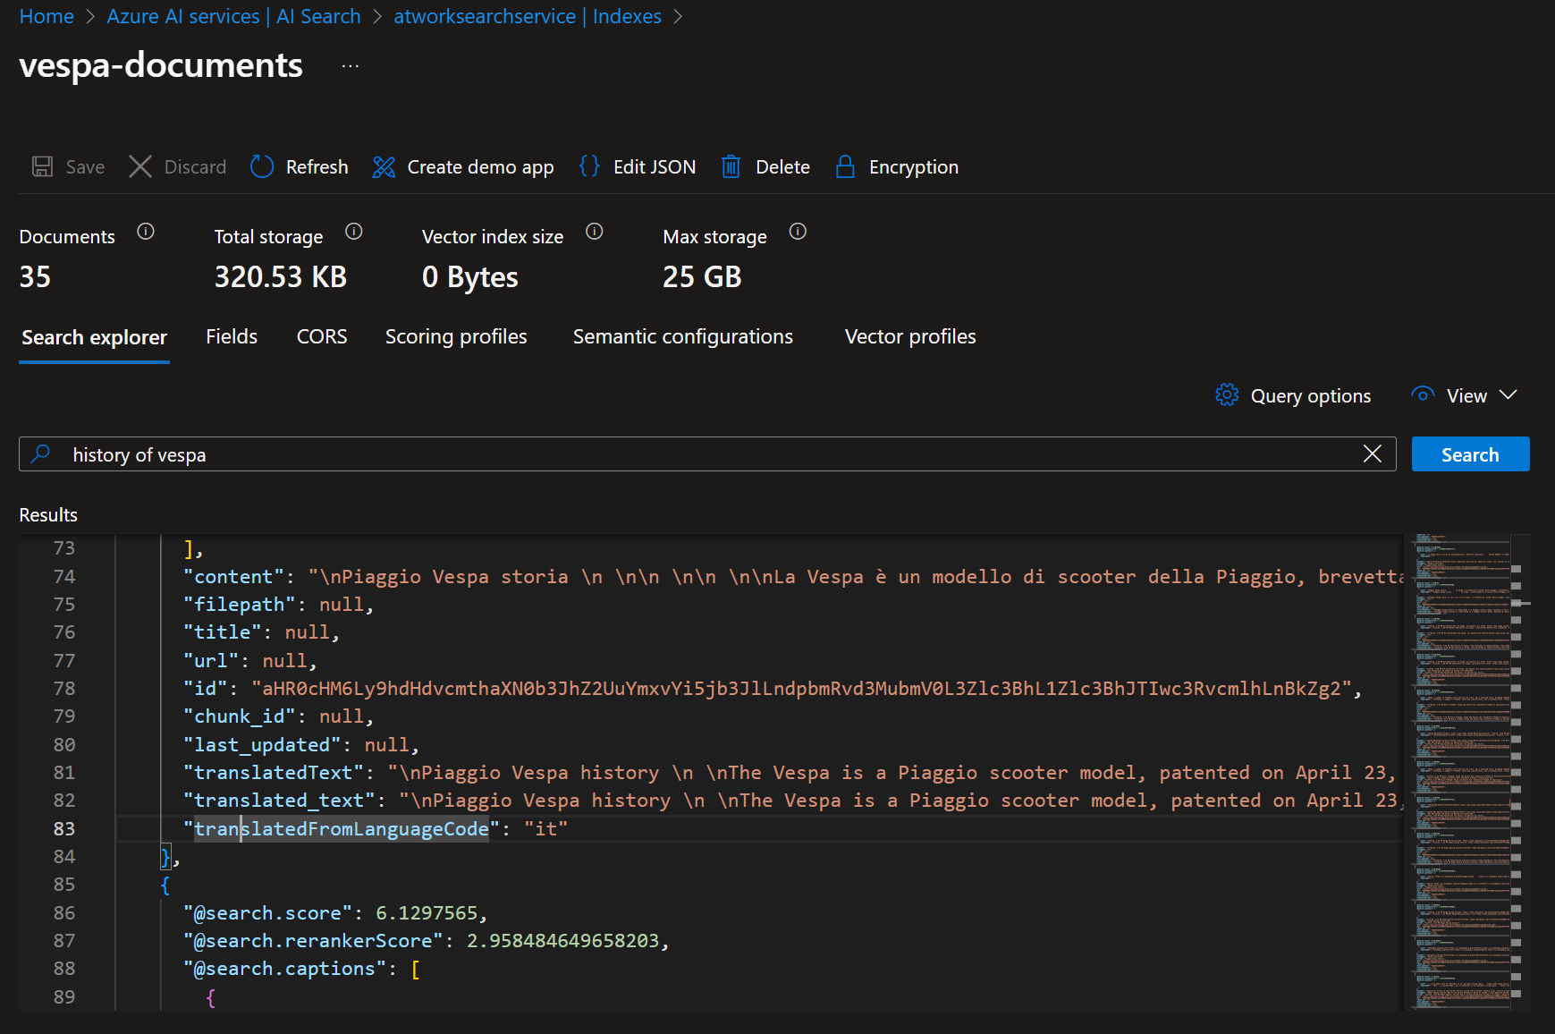

Slide 40
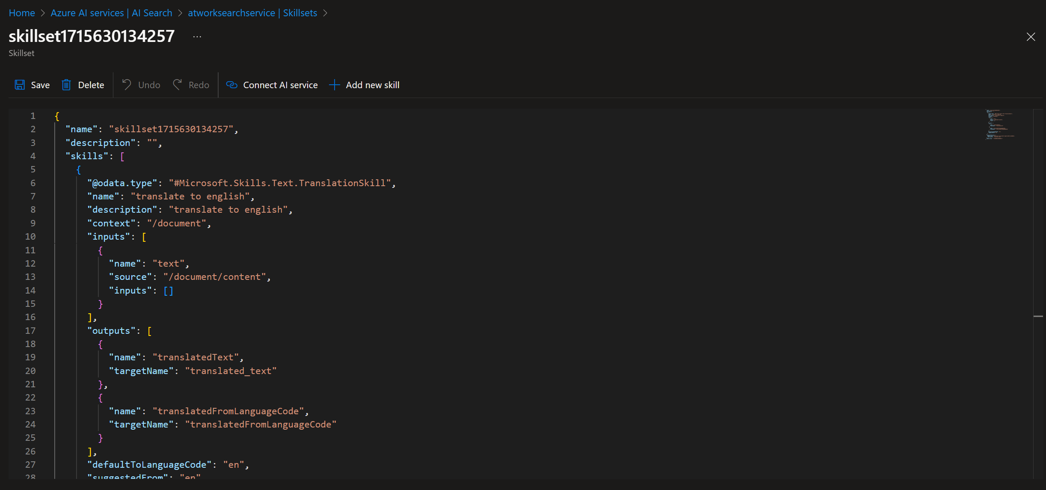

Slide 41
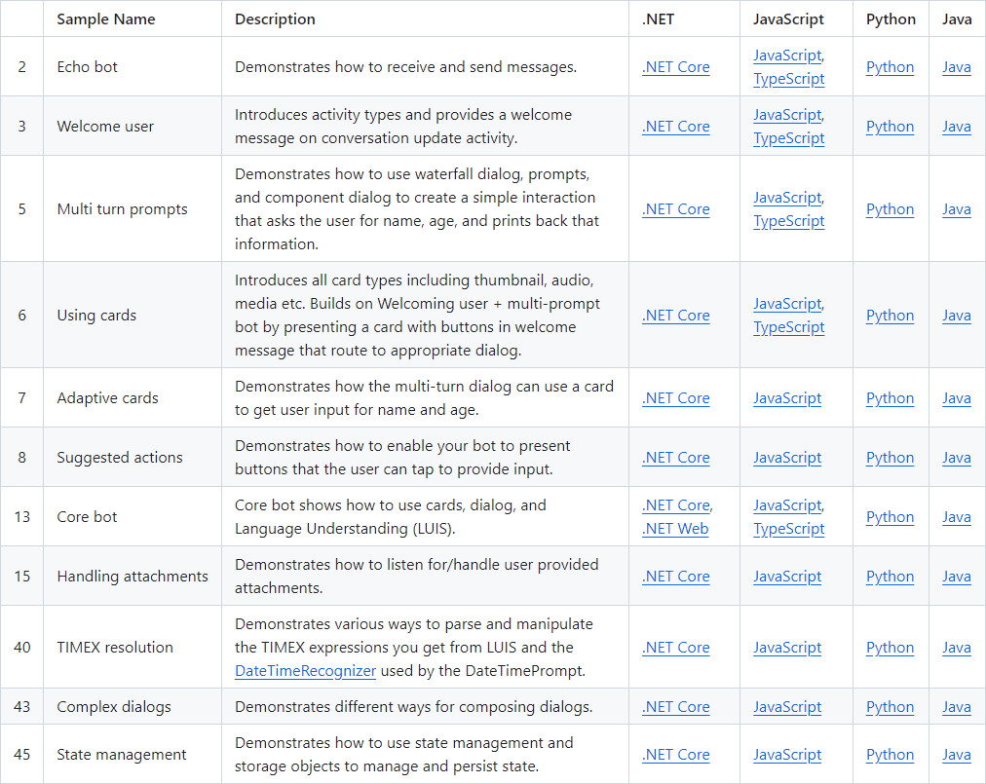
https://github.com/Microsoft/BotBuilder-Samples/blob/main/README.md#getting-the-samples
Notes:
https://github.com/Microsoft/BotBuilder-Samples/blob/main/README.md#getting-the-samples

